Slide 1
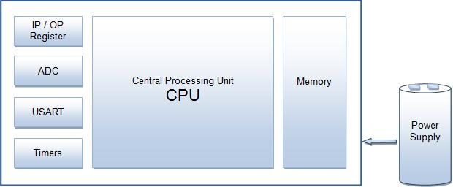
AVR
Microcontroller: Microcontroller can be termed as a single on chip computer which includes number of peripherals like RAM, EEPROM, Timers etc., required to perform some predefined task.

Slide 2
History of AVR
AVR was developed in the year 1996 by Atmel Corporation.
The architecture of AVR was developed by Alf-Egil Bogen and Vegard Wollan. AVR derives its name from its developers and stands for Alf-Egil Bogen Vegard Wollan RISC microcontroller, also known as Advanced Virtual RISC.
The AT90S8515 was the first microcontroller which was based on AVR architecture however the first microcontroller to hit the commercial market was AT90S1200 in the year 1997.

Slide 3
AVR Microcontrollers
There are variety of AVR microcontrollers all are 8 bit controller except AVR32.
One problem with AVR microcontrollers is that they are not 100% compatible in terms of software when going from one family to another.

Slide 4
AVR Microcontrollers
AVR microcontrollers are available in three categories:
1. TinyAVR – Less memory, small size, suitable only for simpler applications
2. MegaAVR – These are the most popular ones having good amount of memory (upto 256 KB), higher number of inbuilt peripherals and suitable for moderate to complex applications.
3. XmegaAVR – Used commercially for complex applications, which require large program memory and high speed.

Slide 5
AVR Microcontrollers
AVR is an 8-bit microcontroller belonging to the family of Reduced Instruction Set Computer (RISC). In RISC architecture the instruction set of the computer are not only fewer in number but also simpler and faster in operation.
This means that the microcontroller is capable of transmitting and receiving 8-bit data. The input/output registers available are of 8-bits. The AVR family controllers have register based architecture which means that both the operands for an operation are stored in a register and the result of the operation is also stored in a register.

Slide 6
AVR Microcontrollers
Atmega16 microcontroller, which is a 40-pin IC and belongs to the megaAVR category of AVR family. Some of the features of Atmega16 are:
· 16KB of Flash memory
· 1KB of SRAM
· 512 Bytes of EEPROM
· Available in 40-Pin DIP
· 8-Channel 10-bit ADC
· Two 8-bit Timers/Counters
· One 16-bit Timer/Counter
· 4 PWM Channels
· In System Programmer (ISP)
· Serial USART
· SPI Interface
· Digital to Analog Comparator.

Slide 7
Atmega16 Microcontroller
Architecture of these microcontrollers are based on the advanced RISC architecture and consist of 32 x 8-bit general purpose working registers.
Follows Harvard Architecture format in which the processor is equipped with separate memories and buses for Program and the Data information.
Since AVR can perform single cycle execution, it means that AVR can execute 1 million instructions per second if cycle frequency is 1MHz. The higher is the operating frequency of the controller, the higher will be its processing speed. We need to optimize the power consumption with processing speed and hence need to select the operating frequency accordingly.

Slide 8
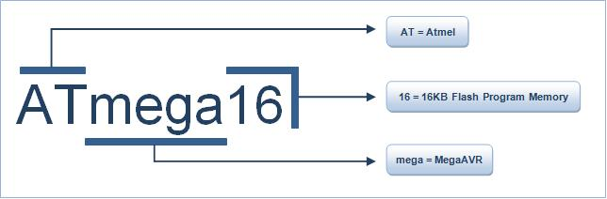
Atmega16 Microcontroller
There are two flavors for Atmega16 microcontroller:
1. Atmega16:- Operating frequency range is 0 – 16 MHz.
2. Atmega16L:- Operating frequency range is 0 – 8 MHz.
The AT refers to Atmel the manufacturer, Mega means that the microcontroller belong to MegaAVR category, 16 signifies the memory of the controller, which is 16KB.

Slide 9
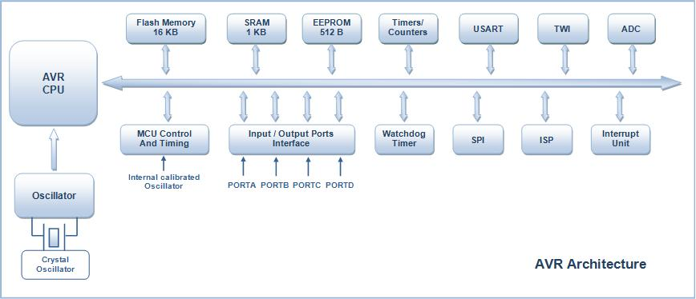
Atmega16 Architecture

Slide 10
Atmega16 Architecture
I/O Ports: Atmega16 has four (PORTA, PORTB, PORTC and PORTD) 8-bit input-output ports.
Internal Calibrated Oscillator: Atmega16 is equipped with an internal oscillator for driving its clock. By default Atmega16 is set to operate at internal calibrated oscillator of 1 MHz. The maximum frequency of internal oscillator is 8Mhz. Alternatively, ATmega16 can be operated using an external crystal oscillator with a maximum frequency of 16MHz.
ADC Interface: Atmega16 is equipped with an 8 channel ADC (Analog to Digital Converter) with a resolution of 10-bits. ADC reads the analog input for e.g., a sensor input and converts it into digital information which is understandable by the microcontroller.
Timers/Counters: Atmega16 consists of two 8-bit and one 16-bit timer/counter. Timers are useful for generating precision actions for e.g., creating time delays between two operations.

Slide 11
Atmega16 Architecture
Watchdog Timer: Watchdog timer is present with internal oscillator. Watchdog timer continuously monitors and resets the controller if the code gets stuck at any execution action for more than a defined time interval.
Interrupts: Atmega16 consists of 21 interrupt sources out of which four are external. The remaining are internal interrupts which support the peripherals like USART, ADC, Timers etc.
USART: Universal Synchronous and Asynchronous Receiver and Transmitter interface is available for interfacing with external device capable of communicating serially (data transmission bit by bit).

Slide 12
Atmega16 Architecture
General Purpose Registers: Atmega16 is equipped with 32 general purpose registers which are coupled directly with the Arithmetic Logical Unit (ALU) of CPU.
Memory: Atmega16 consist of three different memory sections:
1. Flash EEPROM: Flash EEPROM or simply flash memory is used to store the program dumped or burnt by the user on to the microcontroller. It can be easily erased electrically as a single unit. Flash memory is non-volatile i.e., it retains the program even if the power is cut-off. Atmega16 is available with 16KB of in system programmable Flash EEPROM.
2. Byte Addressable EEPROM: This is also a nonvolatile memory used to store data like values of certain variables. Atmega16 has 512 bytes of EEPROM.
3. SRAM: Static Random Access Memory, this is the volatile memory of microcontroller i.e., data is lost as soon as power is turned off. Atmega16 is equipped with 1KB of internal SRAM. A small portion of SRAM is set aside for general purpose registers used by CPU and some for the peripheral subsystems of the microcontroller.

Slide 13
Atmega16 Architecture
ISP: AVR family of controllers have In System Programmable Flash Memory which can be programmed without removing the IC from the circuit, ISP allows to reprogram the controller while it is in the application circuit.
DAC: Atmega16 is also equipped with a Digital to Analog Converter (DAC) interface which can be used for reverse action performed by ADC. DAC can be used when there is a need of converting a digital signal to analog signal.

Slide 14
Atmega16 Architecture
MegaAVR Family
Various microcontroller of MegaAVR series:
ATmega8 and Atmega32 are other members of MegaAVR series controllers. They are quite similar to ATmega16 in architecture. Low power version MegaAVR controllers are also available in markets. The following table shows the comparison between different members of MegaAVR family:
Part Name ROM RAM EEPROM I/0 Pins Timer Interrupts OperationVoltage Operating frequency Packaging
ATmega8 8KB 1KB 512B 23 3 19 4.5-5.5 V 0-16 MHz 28
ATmega8L 8KB 1KB 512B 23 3 19 2.7-5.5 V 0-8 MHz 28
ATmega16 16KB 1KB 512B 32 3 21 4.5-5.5 V 0-16 MHz 40
ATmega16L 16KB 1KB 512B 32 3 21 2.7-5.5 V 0-8 MHz 40
ATmega32 32KB 2KB 1KB 32 3 21 4.5-5.5 V 0-16 MHz 40
ATmega32L 32KB 2KB 1KB 32 3 21 2.7-5.5 V 0-8 MHz 40

Slide 15
AVR Microcontrollers
AVR Registers:
AVR is 8 bit microcontroller therefore all its ports are 8 bit wide. Every port has 3 registers associated with it each one have size of 8 bits. Every bit in those registers configures the pins of particular port. Bit0 of these registers are associated with Pin0 of the port, Bit1 of these registers are associated with Pin1 of the port, and same as for other bits.
The three registers available in AVR microcontroller are as follows:
DDRx register
PORTx register
PINx register

Slide 16
AVR Microcontrollers
DDRx register:
Data Direction Register configures the data direction of port pins. These registers are used for determining whether port pins will be used for input or output. On writing 1 to a bit in DDRx makes corresponding port pin as output, while writing 0 to a bit in DDRx makes corresponding port pin as input.
For example:
For making all pins of port A as output pins:
DDRA= 0b11111111;
For making all pins of port A as input pins:
DDRA= 0b00000000;
For making lower nibble of port B as output and higher nibble as input:
DDRB=0b00001111;

Slide 17
AVR Microcontrollers
PORTx register:
In general PORTx register can be used for two purposes:
To output data: when port is configured as output then PORTx register is used. When we set bits in DDRx to 1, corresponding pins becomes output pins. Now we can write the data into respective bits in PORTx register. This will immediately change the output state of pins according to data we have written on the ports.
PINx register:
PINx register used to read the data from port pins. In order to read the data from port pin, first we have to change the ports data direction to input. This is done by setting bits in DDRx to zero. If port is made output, then reading PINx register will give a data that has been output on port pins.
There are two input modes. Either we can use port pins as internal pull up or as tri stated inputs. It will be explained as shown below:
For reading the data from port A,
DDRA = 0x00; //Set port A as input
x = PINA; //Read contents of port a

Slide 18
AVR Microcontrollers
AVR Memory:
AVR microcontrollers are built using a modified Harvard Architecture. This means the Flash Program Memory space is on a separate address bus than the Static Random Access Memory (SRAM). There are two data bus, one that can access all data and the In/Out data bus with limited access to a small section of memory.

Slide 19
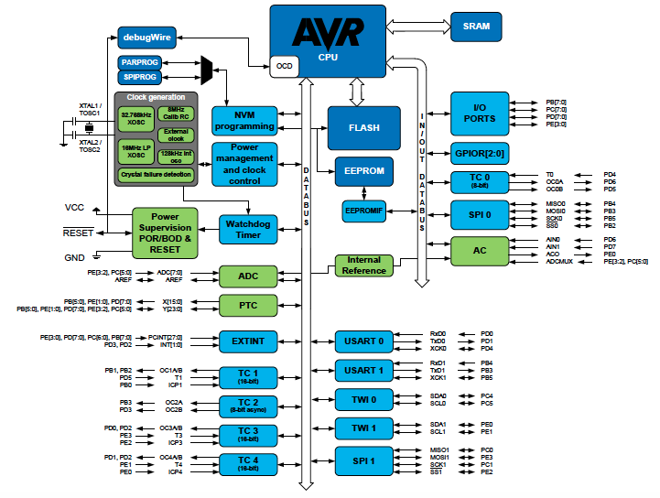
AVR Microcontrollers

Slide 20
AVR Microcontrollers
AVR Memory Program Memory
The AVR microcontrollers contain On-chip In-System Reprogrammable Flash memory for program storage. Since all AVR instructions are 16 or 32 bits wide, the Flash is organized as 32K x 16. For software security, the Flash Program memory space is divided into two sections - Boot Loader Section and Application Program Section in the device. The Flash memory has a typical endurance of at least 10,000 write/erase cycles. Constant tables can be allocated within the entire program memory address space, using the Load Program Memory (LPM) instruction.

Slide 21
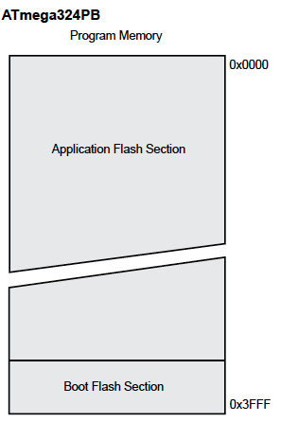
AVR Microcontrollers

Slide 22
AVR Microcontrollers
EEPROM Data Memory
Data electrically erasable programmable read-only memory (EEPROM) is organized as a separate data space, in which single bytes can be read and written. Access from the CPU to EEPROM is done through the EEPROM Address Registers, the EEPROM Data Register, and the EEPROM Control Register. The EEPROM has an endurance of at least 100,000 write/erase cycles.
SRAM Data Memory
Data can be accessed through the standard data bus. There is a secondary In/Out bus for rapid direct access to select locations.
Data memory consists of :
Registers
I/O Memory
Extended I/O Memory (Device dependent)
Internal SRAM

Slide 23
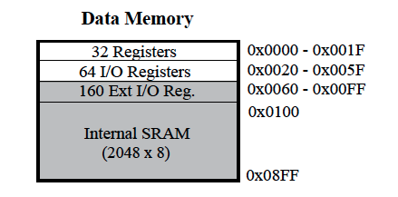
AVR Microcontrollers
Register space - consists of 32 general purpose working 8-bit registers (R0-R31).
I/O Memory - contains addressable space for peripheral functions, such as control registers and other I/O functions.
Extended I/O Memory - Some AVR microcontrollers with more peripherals need more space than the I/O memory can address so some of the SRAM is used as Extended I/O memory to handle the extra peripherals control registers and other I/O functions.
Internal SRAM (Data Memory) - is used for temporarily storing intermediate results and variables within a software application.

Slide 24
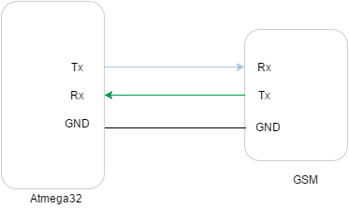
AVR Microcontrollers
Serial UART Interface with AVR:
An embedded product without a Universal Asynchrounous Receiver Transmiter (UART) interface is unimaginable.

Slide 25
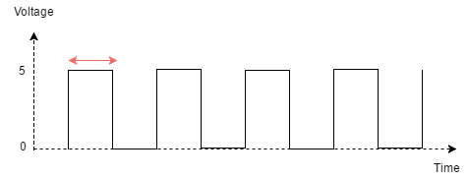
AVR Microcontrollers
The duration of a '1' or '0' is unknown to the receiving device. Hence it asynchronous. This is solved by agreeing upon a common data rate by both the devices, known as baud Rate.
You'll find typical baud rates to be 4800, 9600, 19200, 115200 etc. Atmega32 allows you to select the baud rate you wish. You need to look at the baud rate of the interfacing device to know it's default value. Typically most devices are set to 9600.

Slide 26
AVR Microcontrollers
The Serial Peripheral Interface (SPI)
The SPI (Serial Peripheral Interface) is a peripheral used to communicate between the AVR and other devices, like others AVRs, external EEPROMs, DACs, ADCs, etc.
With this interface, you have one Master device which initiates and controls the communication, and one or more slaves who receive and transmit to the Master.
The core of the SPI is an 8-bit shift register in both the Master and the Slave, and a clock signal generated by the Master. Let's say the Master wants to send a byte of data (call it A) to the Slave and at the same time receive another byte of data from the Slave (call it B). Before starting the communication, the Master places A in its shift register, and the Slave places B in its shift register. (Figure 1-a). Then the Master generates 8 clock pulses, and the contents of the Master's shift register are transferred to the Slave's shift register and vice versa (Figure 1-b to 1-e). So, at the end of the clock pulses, the Master has completely received B, and the Slave has received A. As you can see, the transmission and reception occurs at the same time, so it is a full duplex data transfer.

Slide 27
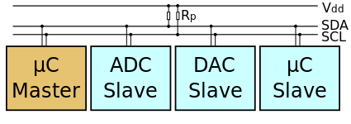
AVR Microcontrollers
Basics of I2C with AVR
The I²C (Inter-Integrated Circuit) protocol, referred to as I-squared-C, I-two-C, or IIC) is two wire serial communication protocol for connecting low speed peripherals to a microcontroller or computer motherboard.
The I²C simply require only two wires for communication. One is called the Serial Data (SDA) and the other is Serial Clock (SCL) as shown.
There are various modes and configurations in which it can be used. Let us start simply with a single master and a single slave.
The Master generates the clock for serial communication (SCL). A stream of data bits(B1 to BN) is transferred between the start and the stop bits.

Slide 28
AVR Microcontrollers
Watchdog timer in AVR:
A watchdog timer (sometimes called a computer operating properly or COP timer, or simply a watchdog) is an electronic timer that is used to detect and recover from computer malfunctions. During normal operation, the computer regularly resets the watchdog timer to prevent it from elapsing, or "timing out". If, due to a hardware fault or program error, the computer fails to reset the watchdog, the timer will elapse and generate a timeout signal. The timeout signal is used to initiate corrective action or actions. The corrective actions typically include placing the computer system in a safe state and restoring normal system operation.
Watchdog timers are commonly found in embedded systems and other computer-controlled equipment where humans cannot easily access the equipment or would be unable to react to faults in a timely manner. In such systems, the computer cannot depend on a human to invoke a reboot if it hangs; it must be self-reliant.

Slide 29
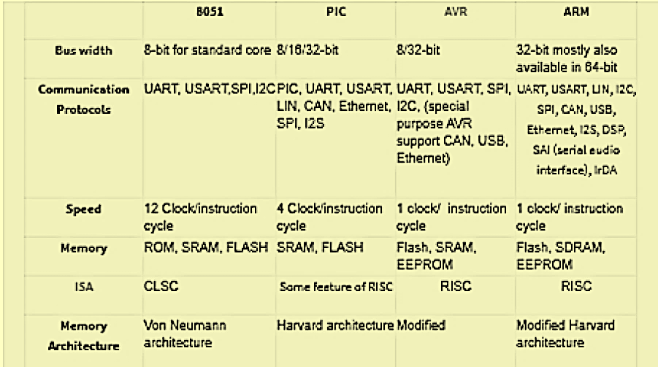
Comparison
<number>

Slide 30
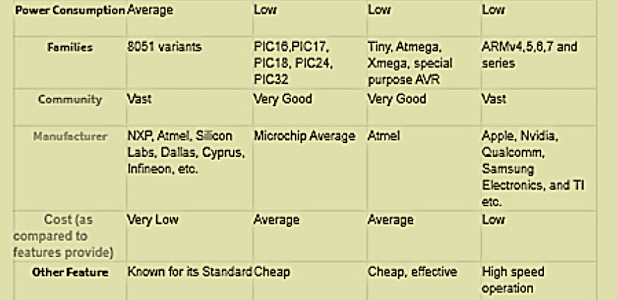
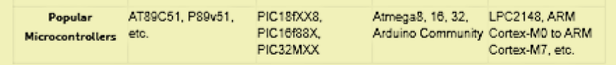
PIC Vs. AVR Vs. ARM
<number>

Slide 31
ARM History
ARM (Acorn RISC Machine) started as a new, powerful, CPU design for the replacement of the 8-bit 6502 in Acorn Computers (Cambridge, UK, 1985)
First models had only a 26-bit program counter, limiting the memory space to 64 MB (not too much by today standards, but a lot at that time).
1990 spin-off: ARM renamed Advanced RISC Machines
** https://community.arm.com/developer/ip-products/processors/b/processors-ip-blog/posts/a-brief-history-of-arm-part-1
05/18/2021
ARM Architecture
<number>

Slide 32
ARM History ....
ARM now focuses on Embedded CPU cores
IP licensing: Almost every silicon manufacturer sells some microcontroller with an ARM core.
Some even compete with their own designs.
Processing power with low current consumption
Good MIPS/Watt figure
Ideal for portable devices
Compact memories: 16-bit opcodes (Thumb)
** https://community.arm.com/developer/ip-products/processors/b/processors-ip-blog/posts/a-brief-history-of-arm-part-1
05/18/2021
ARM Architecture
<number>

Slide 33
ARM History ....
New cores with added features
Harvard architecture (ARM9, ARM11, Cortex)
Vector computing (VFP, NEON)
Java language (Jazelle)
** https://community.arm.com/developer/ip-products/processors/b/processors-ip-blog/posts/a-brief-history-of-arm-part-1
05/18/2021
ARM Architecture
<number>

Slide 34
ARM Introduction
32-bit CPU
RISC design…
Few, simple, instructions
Load/store architecture (instructions operate on registers, not memory)
Large register set
Pipelined execution
Multiplication and Load/Store Multiple are complex instructions (many cycles longer than regular, RISC, instructions)
** https://developer.arm.com/architectures/instruction-sets
05/18/2021
ARM Architecture
<number>

Slide 35
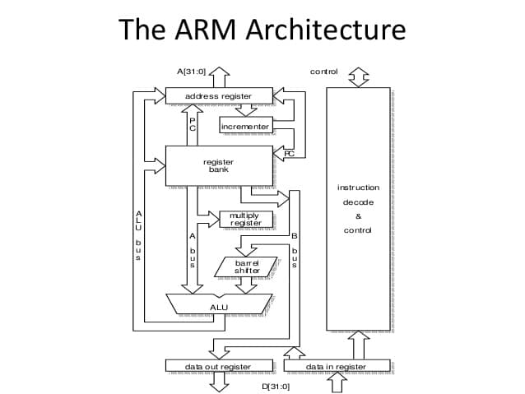
Architecture
Memory-mapped I/O:
No specific instructions for I/O (use Load/Store instr. instead)
Peripheral’s registers at some memory addresses
Link: https://piembsystech.com/arm-microcontroller/
05/18/2021
ARM Architecture
<number>

Slide 36
05/18/2021
ARM Architecture
<number>

Slide 37
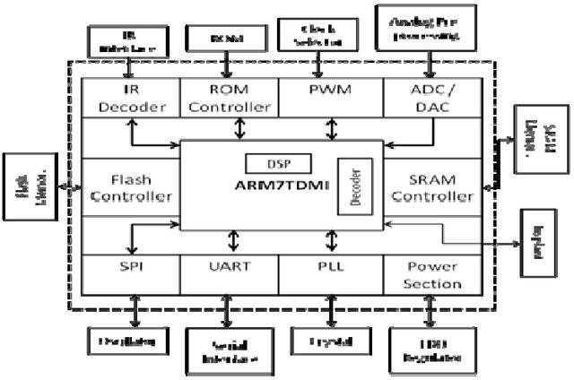
ARM7TDMI (Block Diagram)
Link: https://www.researchgate.net/publication/50257309_Low_Power_Architecture_For_Cochlear_Implant/figures?lo=1
05/18/2021
ARM Architecture
<number>

Slide 38
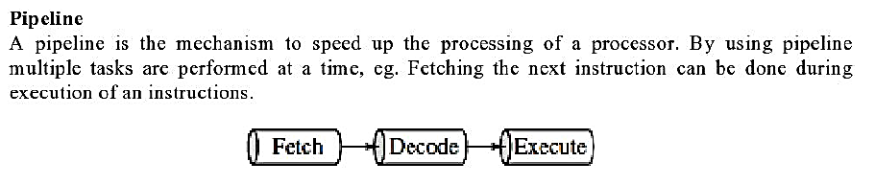
Pipelines
<number>

Slide 39
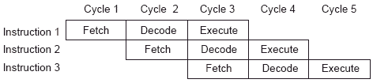
ARM Pipelining
Fetch: Read Op-code from memory to internal Instruction Register
Decode: Activate the appropriate control lines depending on Opcode
Execute: Do the actual processing
Link: https://scienceprog.com/how-does-arm7-pipelining-works/
05/18/2021
ARM Architecture
<number>

Slide 40
ARM cortex series
The ARM cortex is a complicated microcontroller within the ARM family that has ARMv7 design. There are 3 subfamilies within the ARM cortex family :
ARM Cortex Ax-series
ARM-Cortex Rx-series
ARM-Cortex Mx-series
**https://www.watelectronics.com/arm-processor-architecture-working/#:~:text=The%20ARM%20microcontroller%20stands%20for,Computers%20in%20the%20year%201985.
05/18/2021
ARM Architecture
<number>

Slide 41
The ARM Architecture
The ARM Architecture contains following units
Arithmetic Logic Unit
Barrel shifter
Control unit
Register file
**https://www.watelectronics.com/arm-processor-architecture-working/#:~:text=The%20ARM%20microcontroller%20stands%20for,Computers%20in%20the%20year%201985.
05/18/2021
ARM Architecture
<number>

Slide 42
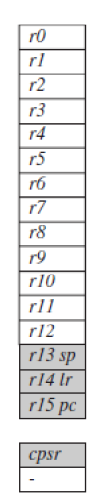
ARM Registers
<number>

Slide 43
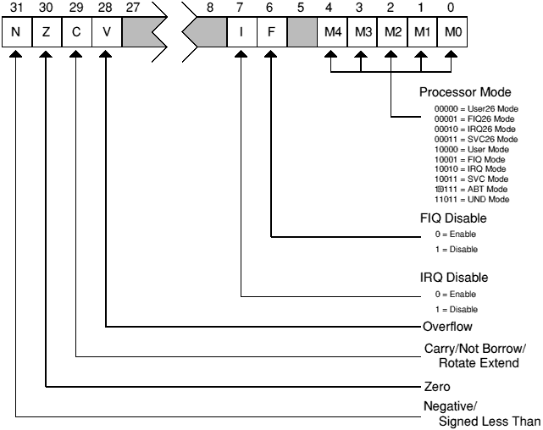
Current Program Status Register
<number>

Slide 44
Register Modes......
USER Mode
FIQ Mode
IRQ Mode
SVC Mode
UNDEFINED Mode
ABORT Mode
Monitor Mode
**https://www.watelectronics.com/arm-processor-architecture-working/#:~:text=The%20ARM%20microcontroller%20stands%20for,Computers%20in%20the%20year%201985.
05/18/2021
ARM Architecture
<number>

Slide 45
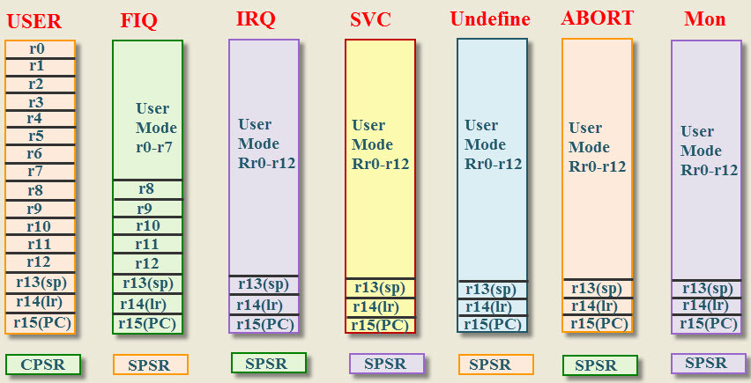
ARM Microcontroller Register Modes........
Link: https://www.watelectronics.com/arm-processor-architecture-working/
05/18/2021
ARM Architecture
<number>

Slide 46
ARM Microcontroller Register Modes........
USER Mode:
The user mode is a normal mode, which has the least number of registers.
It doesn’t have SPSR and has limited access to the CPSR.
** https://www.watelectronics.com/arm-processor-architecture-working/
05/18/2021
ARM Architecture
<number>

Slide 47
ARM Microcontroller Register Modes........
FIQ and IRQ:
The FIQ and IRQ are the two interrupt caused modes of the CPU.
The FIQ is processing interrupt and IRQ is standard interrupt.
The FIQ mode has additional five banked registers to provide more flexibility and high performance when critical interrupts are handled.
** https://www.watelectronics.com/arm-processor-architecture-working/
05/18/2021
ARM Architecture
<number>

Slide 48
ARM Microcontroller Register Modes........
SVC Mode:
The Supervisor mode is the software interrupt mode of the processor to start up or reset.
Undefined Mode:
The Undefined mode traps when illegal instructions are executed.
The ARM core consists of 32-bit data bus and faster data flow.
** https://www.watelectronics.com/arm-processor-architecture-working/
05/18/2021
ARM Architecture
<number>

Slide 49
ARM Microcontroller Register Modes........
THUMB Mode:
In THUMB mode 32-bit data is divided into 16-bits and increases the processing speed.
THUMB-2 Mode:
In THUMB-2 mode the instructions can be either 16-bit or 32-bit and it increases the performance of the ARM cortex –M3 microcontroller.
The ARM cortex-m3 microcontroller uses only THUMB-2 instructions.
** https://www.watelectronics.com/arm-processor-architecture-working/
05/18/2021
ARM Architecture
<number>

Slide 50
Reserved Registers
Some of the registers are reserved in each mode for the specific use of the core. The reserved registers are
Stack Pointer (SP).
Link Register (LR).
Program Counter (PC).
Current Program Status Register (CPSR).
Saved Program Status Register (SPSR).
** https://www.watelectronics.com/arm-processor-architecture-working/
05/18/2021
ARM Architecture
<number>

Slide 51
Reserved Registers.......
The reserved registers are used for specific functions.
The SPSR and CPSR contain the status control bits which are used to store the temporary data.
The SPSR and CPSR register have some properties that are defined operating modes, Interrupt enable or disable flags and ALU status flag.
The ARM core operates in two states 32-bit state or THUMBS state.
** https://www.watelectronics.com/arm-processor-architecture-working/
05/18/2021
ARM Architecture
<number>

Slide 52
ARM Instruction Set
ARM instructions are all 32 -bit long (except for Thumb mode) Thumb mode).
There are 2³² possible machine instructions.
Fortunately they Fortunately , they are structured.
**https://profile.iiita.ac.in/bibhas.ghoshal/lecture_slides_coa/arm_inst.pdf
05/18/2021
ARM Architecture
<number>

Slide 53
Instruction set
An ARM processor have 3 types of instruction sets:
Data processing
Data movement
Flow control
**https://profile.iiita.ac.in/bibhas.ghoshal/lecture_slides_coa/arm_inst.pdf
05/18/2021
ARM Architecture
<number>

Slide 54
Arithmetic Logic Unit (ALU)
The ALU has two 32-bits inputs.
The primary comes from the register file, whereas the other comes from the shifter.
Status registers flags modified by the ALU outputs. The V-bit output goes to the V flag as well as the Count goes to the C flag.
**https://www.watelectronics.com/arm-processor-architecture-working/
05/18/2021
ARM Architecture
<number>

Slide 55
Barrel Shifter
The barrel shifter features a 32-bit input to be shifted.
This input is coming back from the register file or it might be immediate data. The shifter has different control inputs coming back from the instruction register.
The Shift field within the instruction controls the operation of the barrel shifter.
This field indicates the kind of shift to be performed (logical left or right, arithmetic right or rotate right).
** https://www.watelectronics.com/arm-processor-architecture-working/
05/18/2021
ARM Architecture
<number>

Slide 56
Control Unit
For any microprocessor, control unit is the heart of the whole process and it is responsible for the system operation,so the control unit design is the most important part within the whole design.
The control unit is sometimes a pure combinational circuit design.
Here, the control unit is implemented by easy state machine.
The processor timing is additionally included within the control unit. Signals from the control unit are connected to each component within the processor to supervise its operation.
** https://www.watelectronics.com/arm-processor-architecture-working/
05/18/2021
ARM Architecture
<number>

Slide 57
Qualcomm Snapdragon Processors for Mobile Platform
Qualcomm® Snapdragon™ mobile platforms are designed to be fast, intelligent, smooth, and secure with amazing graphics.
They feature processors with multi-core CPUs, combining cutting-edge features and support for worldwide network connectivity with jhigh speeds and unbelievable power efficiency.
Smartphones and mobile devices built with Snapdragon mobile platforms enable immersive augmented reality and virtual reality experiences, brilliant camera capabilities, superior 4G LTE and 5G connectivity, and the latest security solutions.
** https://www.qualcomm.com/products/mobile-processors
05/18/2021
Qualcomm 835
<number>

Slide 58
Generation of Qualcomm Processors
Qualcomm 2 Series Mobile Platforms
Snapdragon 4 Series Mobile Platforms
Snapdragon 6 Series Mobile Platforms
Snapdragon 7 Series Mobile Platforms
Snapdragon 8 Series Mobile Platforms
** https://www.qualcomm.com/products/mobile-processors
05/18/2021
Qualcomm 835
<number>

Slide 59
Snapdragon 8 Series Mobile Platforms
Snapdragon 820 Mobile Platform
Snapdragon 821 Mobile Platform
Snapdragon 835 Mobile Platform
Snapdragon 845 Mobile Platform
Snapdragon 855 Mobile Platform
Snapdragon 855+ Mobile Platform
Snapdragon 865 5-G Mobile Platform
Snapdragon 888 5G Mobile Platform
** https://www.qualcomm.com/products/mobile-processors
05/18/2021
Qualcomm 835
<number>

Slide 60
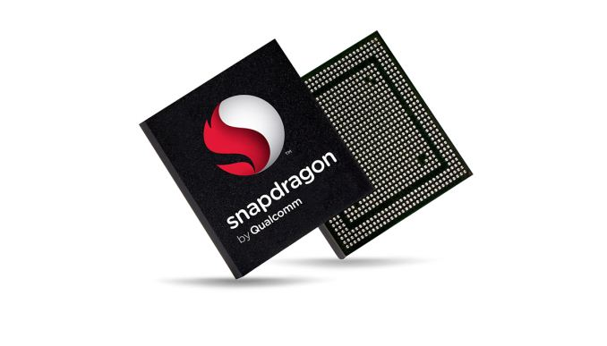
Qualcomm Snapdragon 835 (8998)
The Qualcomm Snapdragon 835 Mobile Platform (MSM8998) is a high-end SoC for smart-phones (mostly Android based) that was released early 2017.
Its one of the first processors that is manufactured in 10 nm (LPE FinFET at Samsung).
**https://www.notebookcheck.net/Qualcomm-Snapdragon-835-SoC-Benchmarks-and-Specs.207842.0.html
05/18/2021
Qualcomm 835
<number>

Slide 61
Qualcomm Snapdragon 835……
With an advanced 10-nanometer design, the Qualcomm Snapdragon-835 mobile platform can support phenomenal mobile performance.
It integrates 4x Kryo 280 at 2.45 GHz (max) for performance and 4x Kryo 280 at 1.9 GHz (max) for efficiency.
**https://www.notebookcheck.net/Qualcomm-Snapdragon-835-SoC-Benchmarks-and-Specs.207842.0.html
05/18/2021
Qualcomm 835
<number>

Slide 62
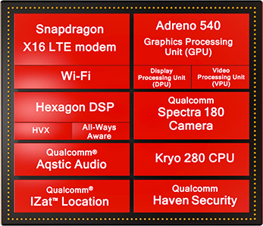
Image Link: https://www.notebookcheck.net/uploads/tx_nbc2/snapdragon_835-soc_overview.png
05/18/2021
Qualcomm 835
<number>

Slide 63
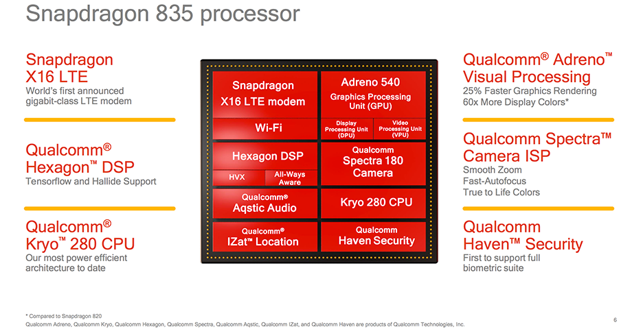
Image Link: https://images.anandtech.com/doci/10948/Snapdragon_835-SoC_Overview.png
05/18/2021
Qualcomm 835
<number>

Slide 64
Qualcomm Snapdragon 835……
The SD-835 is the first commercial SoC to use Samsung’s 10nm "10LPE" FinFET manufacturing node.
Qualcomm did not disclose die size, but it said the overall package size is 35% smaller than the Snapdragon 820 and contains more than 3 billion transistors.
Its third-generation FinFET node “allows up to a 30% increase in area efficiency with 27% higher performance or up to 40% lower power consumption” relative to its first-generation 14nm 14LPE node at the same frequency
Image Link: https://www.notebookcheck.net/uploads/tx_nbc2/snapdragon_835-soc_overview.png
05/18/2021
Qualcomm 835
<number>

Slide 65
Snapdragon 835 mobile platform advancements
Snapdragon X16 LTE modem:
Mobile connectivity with LTE download speeds up to 1 Gbps, multi-gigabit 802.11ad, and integrated 2x2 802.11ac Wi-Fi with MU-MIMO
Qualcomm Quick Charge™ 4 technology:
20% faster, 30% more efficient than our previous generation, charge from zero to up to 50% in 15 minutes
**https://www.qualcomm.com/media/documents/files/snapdragon-835-mobile-platform-product-brief.pdf
05/18/2021
Qualcomm 835
<number>

Slide 66
Snapdragon 835 mobile platform advancements…
Qualcomm Adreno 540 GPU with visual processing subsystem
Advanced 3-D graphics rendering and up to 60X more colors help deliver life-like visuals for immersive experiences
Qualcomm Spectr 180 Camera ISP
Dual 14-bit ISPs support up to 32MP single or dual 16-MP cameras for the ultimate photography and video-graphy experience
**https://www.qualcomm.com/media/documents/files/snapdragon-835-mobile-platform-product-brief.pdf
05/18/2021
Qualcomm 835
<number>

Slide 67
Snapdragon 835 mobile platform advancements…
Qualcomm Hexagon 682 DSP:
Support for latest Machine Learning frameworks and image processing. Includes Hexagon Vector eXtensions and Qualcomm All-Ways Aware™ technology utilizing connectivity and sensors
Qualcomm Kryo 280 CPU:
Manufactured in 10nm FinFET to deliver our most power-eff icient architecture to date
**https://www.qualcomm.com/media/documents/files/snapdragon-835-mobile-platform-product-brief.pdf
05/18/2021
Qualcomm 835
<number>

Slide 68
FEATURES & SPECIFICATIONS
CPU | CPU Clock Speed: Up to 2.45 GHz
 | CPU Cores: Qualcomm Kryo™ 280 CPU, Octa-core CPU
 | CPU Architecture: 64-bit
Process | Process Technology: 10 nm
DSP | DSP Technology: Qualcomm Hexagon 682 DSP, Qualcomm All-Ways Aware technology
**https://www.qualcomm.com/products/snapdragon-835-mobile-platform
05/18/2021
Qualcomm 835
<number>

Slide 69
FEATURES & SPECIFICATIONS
Wi-Fi | Standards: 802.11ad, 802.11ac Wave 2, 802.11a/b/g, 802.11n
 | Wi-Fi Spectral Bands: 2.4GHz, 5GHz, 60GHz
 | Peak Speed: 867 Mbps
GPU | GPU Name: Qualcomm Adreno™ 540 GPU
 | API Support: OpenGL ES 3.2, Vulkan 1.1, OpenCL 2.0 full, DX12
**https://www.qualcomm.com/products/snapdragon-835-mobile-platform
05/18/2021
Qualcomm 835
<number>

Slide 70
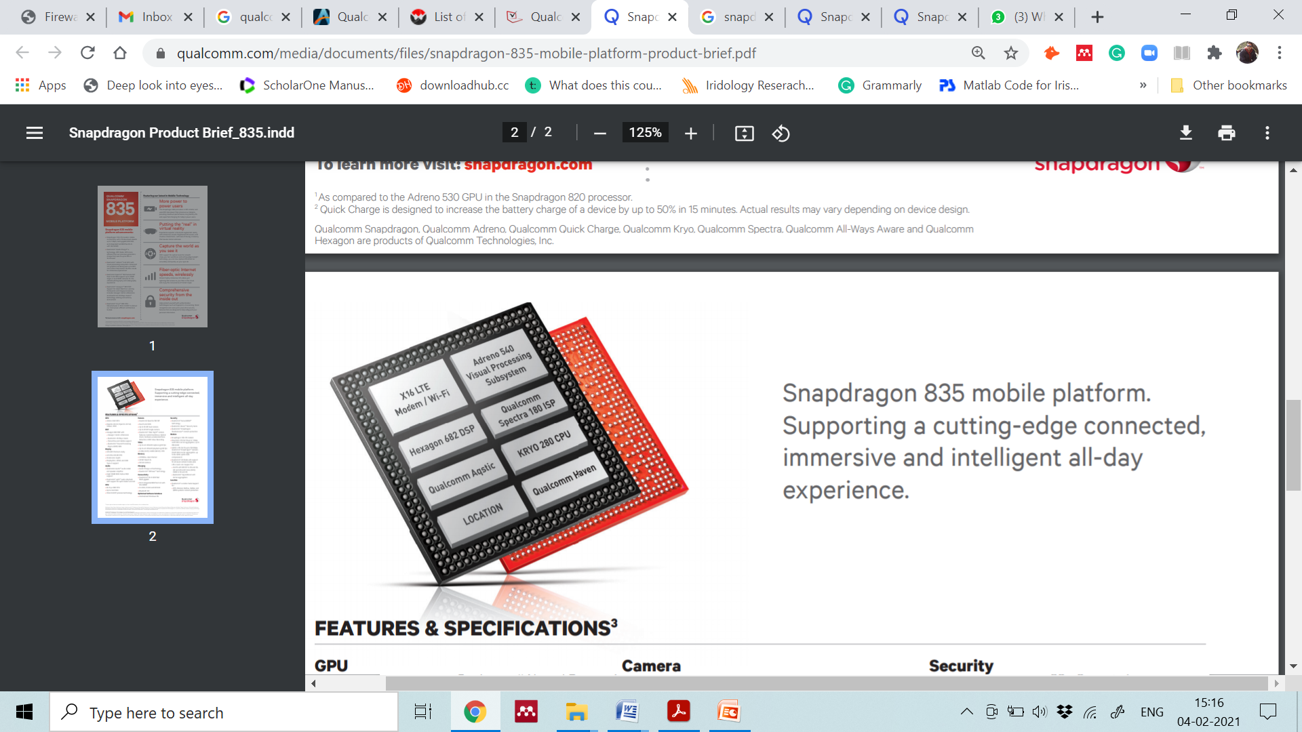
Image ink: https://www.qualcomm.com/products/snapdragon-835-mobile-platform
05/18/2021
Qualcomm 835
<number>

Slide 71
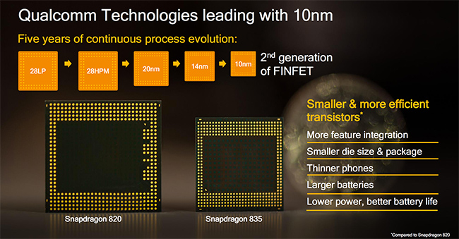
Image Link: https://www.anandtech.com/show/10948/qualcomm-snapdragon-835-kryo-280-adreno-540
05/18/2021
Qualcomm 835
<number>

Slide 72
GPU of SD-835
The Snapdragon 835 includes an updated Adreno 540 GPU
For this generation, Qualcomm focused on optimizing bottlenecks and reducing the amount of work done per pixel by improving depth rejection
for example: The ALUs and register files also received some attention, although, nothing specific was mentioned.
**https://www.anandtech.com/show/10948/qualcomm-snapdragon-835-kryo-280-adreno-540/2
05/18/2021
Qualcomm 835
<number>

Slide 73
GPU of SD-835…
In addition to the two HVX contexts for vector instructions, the Hexagon 680 also contains four threads for scalar instructions, each with 4 VLIW pipelines.
Scalar and vector instructions can be processed in parallel too, using two scalar threads and two vector threads.
This allows concurrent execution of audio and imaging tasks, because the scalar threads generally handle audio and voice processing.
**https://www.anandtech.com/show/10948/qualcomm-snapdragon-835-kryo-280-adreno-540/2
05/18/2021
Qualcomm 835
<number>

Slide 74
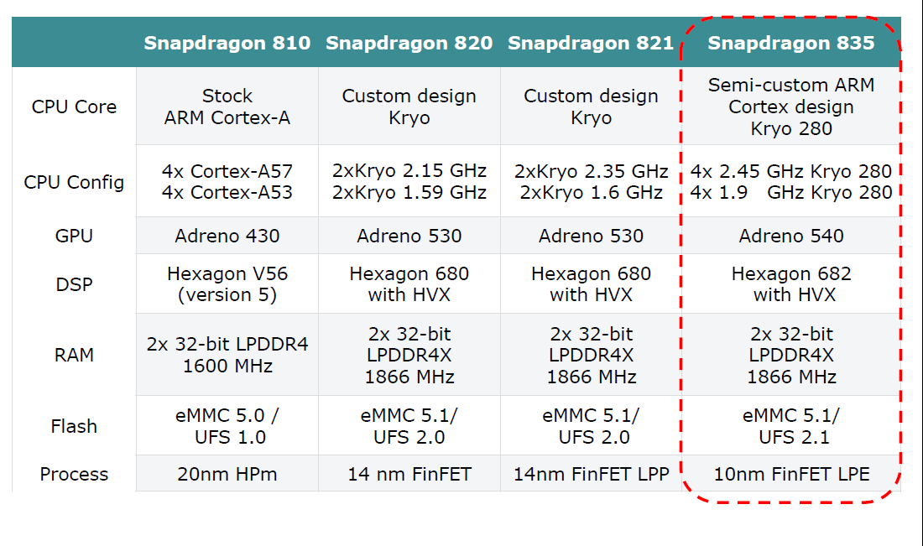
Comparison of SD-835 with its previous processors
05/18/2021
Qualcomm 835
<number>

Slide 75
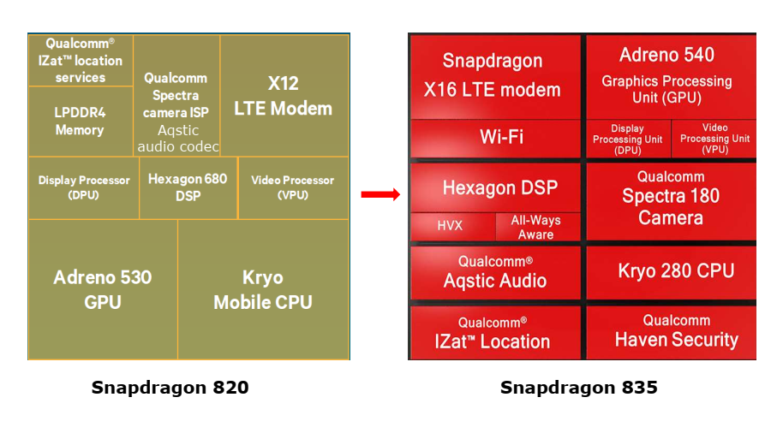
Main functional units of the Snapdragon 835 vs. 820
05/18/2021
Qualcomm 835
<number>

Slide 76
Running Windows 10 and x86 apps on the ARM ISA based Snapdragon 835
The Snapdragon 835 is the first ever ARM processor that is designed to support Windows 10.
On the 2017 Snapdragon Technology Summit (12/2017) Qualcomm has announced the first Windows 10 laptops powered by the Snapdragon 835, these are the ASUS NovaGo and HP’s Envy x2 [84], see the next slide.
These devices provide all day battery life (e.g. 15 or 20 hours).
05/18/2021
Qualcomm 835
<number>

Slide 77
Windows 10 and Smart-phones Powered by Qualcomm Snapdragon 835 Processor
05/18/2021
Qualcomm 835
<number>

Slide 78

Snapdragon 835 based Windows-10 devices
05/18/2021
Qualcomm 835
<number>

Slide 79
Snapdragon 835 based mobile devices
Samsung Galaxy S8 and S8 Plus
Samsung Galaxy Note 8
Google Pixel 2 & Pixel 2 XL
Xiaomi Mi 6
OnePlus 5
05/18/2021
Qualcomm 835
<number>

Slide 80
Qualcomm Snapdragon 845
The Qualcomm Snapdragon 845 Mobile Platform (or SD845) is a high-end SoC for smartphones that was introduced in early 2018 and manufactured in 10 nm LPP FinFET at TSMC.
Integrates 4x Kryo 385 cores (Cortex-A75) at up to 2.8 GHz (max) for performance and 4x Kryo 385 at 1.8 GHz (max) for efficiency.
Furthermore offers an X20 LTE modem (Cat. 18 1.2 Gbps downlink, Cat 13 150 Mbps uplink), ac-WiFi and a dual-channel 32-Bit 1866 MHz LPDDR4x memory controller.
** https://www.notebookcheck.net/Qualcomm-Snapdragon-845-SoC-Benchmarks-and-Specs.299446.0.html
ARM Architecture

Slide 81
Qualcomm Snapdragon 845…..
It is built up on 8 Kryo 385 CPU cores.
The Kryo 385 is a semicustom design and is the first chip that is based on the ARMv8.2-based Cortex-A75 and A-55 cores and ARM’s DynamIQ core technology.
It is a 4 + 4 core design with:
4x Kryo 385 cores clocked at 2.8 GHz.
4x Kryo 385 cores clocked at 1.8 GHz.
Manufactured on Samsung’s 2. gen 10 nm technology, called LPP (LP Plus).
It is the second ARM processor that supports Windows 10, but apparently no Windows 10 tablets or laptops appeared on the market.
** https://www.notebookcheck.net/Qualcomm-Snapdragon-845-SoC-Benchmarks-and-Specs.299446.0.html
ARM Architecture

Slide 82
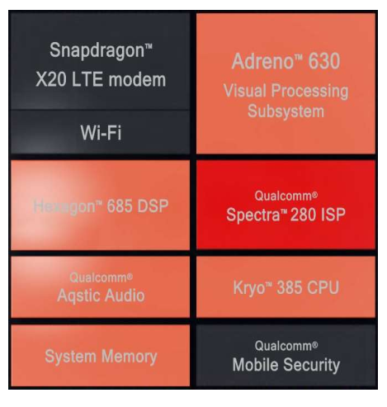
Main functional units of the Snapdragon 845
Image Link: http://www.hardwarezone.com.sg/feature-snapdragon-845-will-deliver-300-more-aiperformance-
4k-hdr-imaging-and-more/ai-immersion-and-connectivity
ARM Architecture

Slide 83
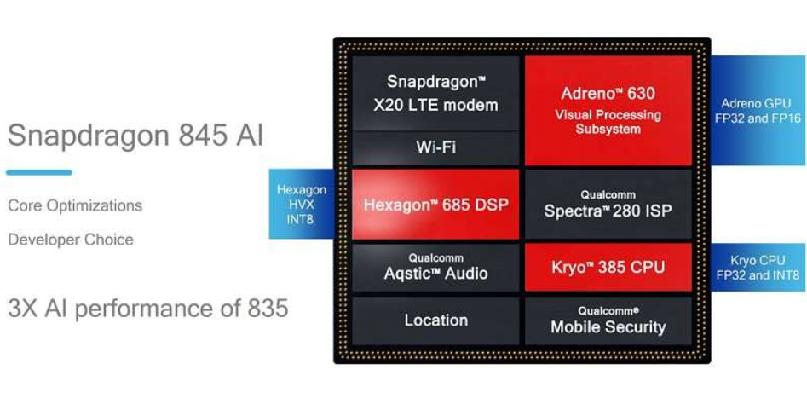
AI execution resources on the Snapdragon 845 processor
Image Link: http://www.hardwarezone.com.sg/feature-snapdragon-845-will-deliver-300-more-aiperformance-
4k-hdr-imaging-and-more/ai-immersion-and-connectivity
ARM Architecture

Slide 84
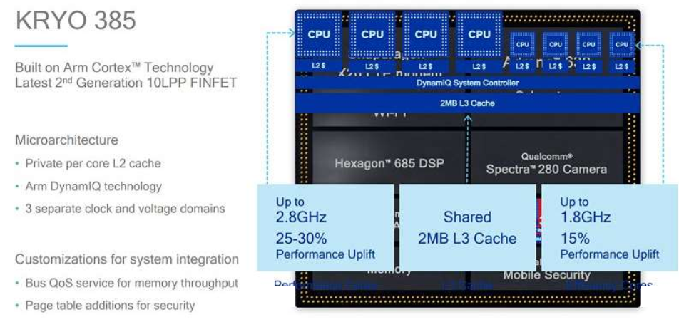
The Kryo 385 CPU
Instead of designing fully customized Kryo cores, Qualcomm based the Kryo 385 on ARM’s DynamIQ core technology and the stock Cortex A75 and A55 cores, as shown below.
Image Link: http://www.hardwarezone.com.sg/feature-snapdragon-845-will-deliver-300-more-aiperformance-
4k-hdr-imaging-and-more/ai-immersion-and-connectivity
ARM Architecture

Slide 85
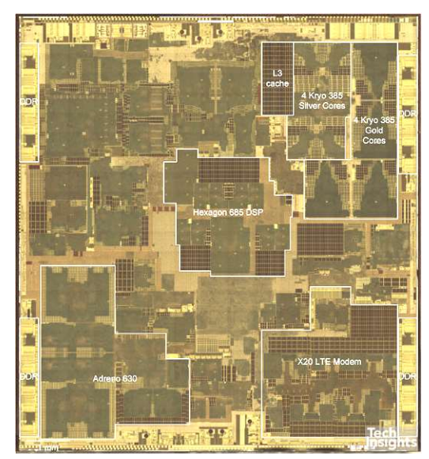
Floor-plan of the Snapdragon 845
**https://www.anandtech.com/print/12520/the-galaxy-s9-review
ARM Architecture

Slide 86
Optimization on the Snapdragon 845
Optimizations on the Snapdragon 845 SOC
The Snapdragon 845 is optimized mainly in two aspects:
Enhancements for the efficient execution of AI tasks and It is achieved by:
• Enhancing the Hexagon line of DSPs for key AI application areas power consumption and performance for AI and imaging
• Introducing the Snapdragon™ Neural Processing Engine (NPE) software development kit (SDK) (already before launching the Snapdragon 845 in 7/2017).
b) enhancements for the efficient execution of non-ARM code (under emulation).
** http://www.hardwarezone.com.sg/feature-snapdragon-845-will-deliver-300-more-aiperformance-
4k-hdr-imaging-and-more/ai-immersion-and-connectivity
ARM Architecture

Slide 87
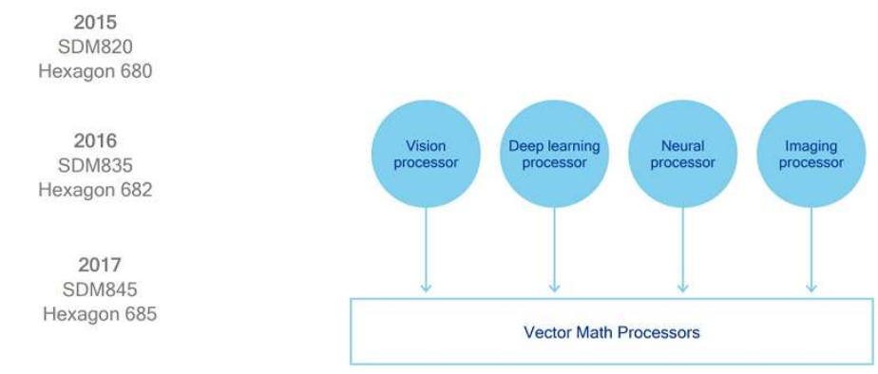
Enhancing the Hexagon line of DSPs for key AI application areas:
The enhancements relate both to power consumption and performance while running AI and imaging tasks.
Release history of Hexagon DSPs (2015-2017)
Image Link: http://www.hardwarezone.com.sg/feature-snapdragon-845-will-deliver-300-more-aiperformance-
4k-hdr-imaging-and-more/ai-immersion-and-connectivity
ARM Architecture

Slide 88
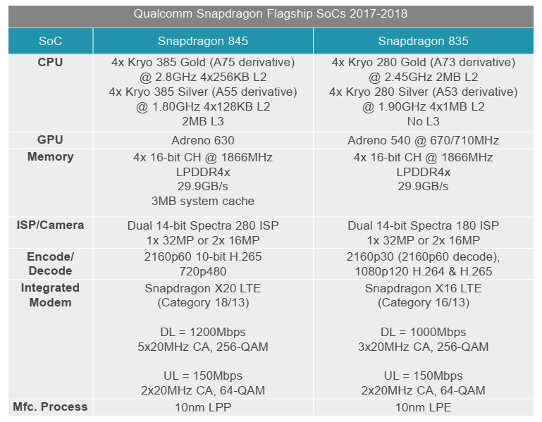
Main features of the Snapdragon 845 vs. that of Snapdragon 835
Image Link: https://www.anandtech.com/show/12114/qualcomm-announces-snapdragon-845-soc
ARM Architecture

Slide 89
Neural Processing Engine (NPE) software development kit
The Snapdragon NPE is designed to provide developers with software tools to accelerate running deep neural network workloads on mobile and other edge devices that are based on Snapdragon processors.
NPE targets on-device neural networks-driven apps in multiple industries, including mobile, automotive, healthcare, security and imaging.
Developers can choose the optimal Snapdragon core including Qualcomm’s Kryo CPU, the Adreno GPU or the Hexagon DSP.
** https://www.qualcomm.com/news/releases/2017/07/25/
snapdragon-neural-processing-engine-now-available-qualcomm-developer
ARM Architecture

Slide 90
Executing AI tasks on the Snapdragon 820-845 processors while using the NPE SDK
NPE is capable to allocate the appropriate computational resources to AI tasks.
TensorFlow/TensorFlow Lite are Google’s frameworks, Caffe/Caffe2 are Facebook’s frameworks whereas ONNX is the new Open Neural Exchange framework available on GitHub.
** http://www.hardwarezone.com.sg/feature-snapdragon-845-will-deliver-300-more-aiperformance-
4k-hdr-imaging-and-more/ai-immersion-and-connectivity
ARM Architecture

Slide 91
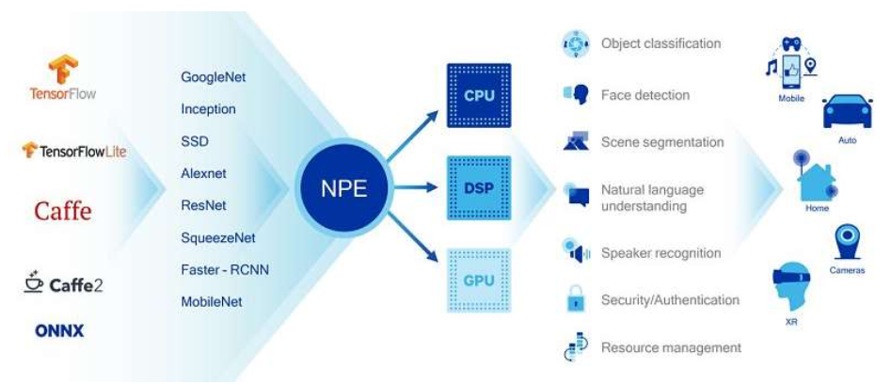
Executing AI tasks on the Snapdragon 820-845 processors while using the NPE SDK
Image Link: http://www.hardwarezone.com.sg/feature-snapdragon-845-will-deliver-300-more-aiperformance-
4k-hdr-imaging-and-more/ai-immersion-and-connectivity
ARM Architecture

Slide 92

Expected Benefits of introducing the Snapdragon NPE SDK
Image Link: http://www.hardwarezone.com.sg/feature-snapdragon-845-will-deliver-300-more-aiperformance-
4k-hdr-imaging-and-more/ai-immersion-and-connectivity
ARM Architecture

Slide 93
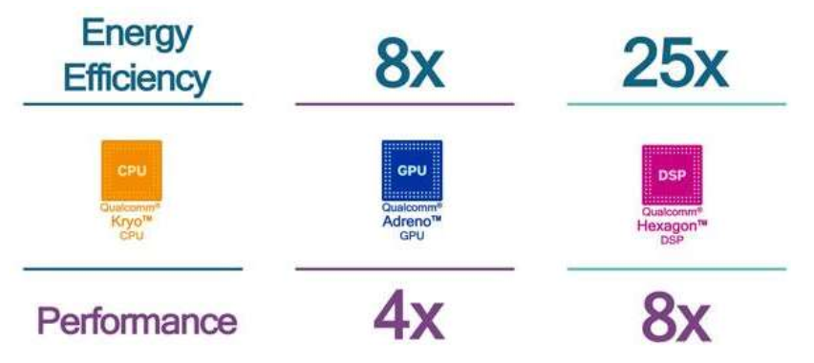
Performance and energy efficiency improvements
Performance and energy efficiency improvements when using TensorFlow and the Hexagon 685 DSP) rather than non-Hexagon devices.
**https://www.xda-developers.com/qualcomm-snapdragon-845-hexagon-685-dsp/
ARM Architecture

Slide 94
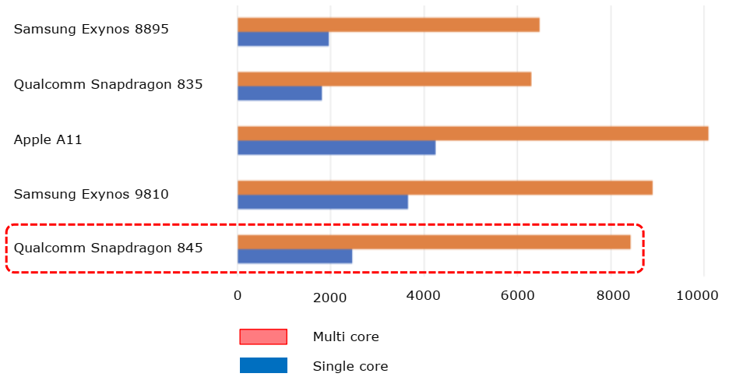
Geekbench 4 scores
Image Linl: https://www.phonearena.com/news/Samsung-Galaxy-S9-S9-Plus-Exynos-9810-
benchmarks-destroy-Snapdragon-845_id102444
ARM Architecture

Slide 95

Qualcomm Snapdragon 855
World’s first commercial 5G mobile platform introduced in 2018 .
2 Gbps LTE modem including the 7x Carrier Aggregation and 14nm RF Chip
The FastConnect 6200 subsystem with Wi-Fi 6 features and 60 GHz Wi-Fi mobile platforms
4K HDR Video Capture and Playback – 10 bit-color depth and Rec. 2020 color gamut can capture over 1 billion shades of color.
05/18/2021
ARM Architecture
<number>

Slide 96
Qualcomm Snapdragon 855.....
Multi-frame Noise Reduction (MFNR) software delivers sharp and color photos even in low light
Computer Vision ISP (CV-ISP) delivers real-time object recognition, segmentation, and replacement to allow users to isolate and swap out backgrounds and objects– in real-time
7 MM design technology makes SD855 20% more efficient than the SD845
05/18/2021
ARM Architecture
<number>

Slide 97
Qualcomm Snapdragon 855 Specifications
Qualcomm® Artificial Intelligence (AI) Engine
AIE GPU: Qualcomm® Adreno™ 640 GPU
AIE CPU: Qualcomm® Kryo™ 485 CPU
Hexagon™ 690 Processor,
Process
Process Technology: 7 nm
05/18/2021
ARM Architecture
<number>

Slide 98
Qualcomm Snapdragon 855 Specifications
CPU
CPU Clock Speed: Up to 2.84 GHz
CPU Cores: Qualcomm® Kryo™ 485 CPU, Octa-core CPU
CPU Architecture: 64-bit
05/18/2021
ARM Architecture
<number>

Slide 99
Qualcomm Snapdragon 855 Specifications
Cellular Modem
Modem Name: Qualcomm® Snapdragon™ X24 LTE modem, Qualcomm® Snapdragon™ X50 Modem-RF System
Peak Download Speed: 2 Gbps
Peak Upload Speed: 316 Mbps
5G Technology: 5G NR
5G Spectrum: nmWave, sub-6 GHz
05/18/2021
ARM Architecture
<number>

Slide 100
Qualcomm Snapdragon 855 Specifications
DSP
DSP Technology: Qualcomm® Hexagon™ 690 Processor,
Qualcomm® Hexagon™ Tensor Accelerator,
Qualcomm® Hexagon™ Voice Assistant,
Qualcomm® Hexagon™ Vector eXtensions (HVX),
Qualcomm All-Ways Aware™ technology
05/18/2021
ARM Architecture
<number>

Slide 101
Camera
Image Signal Processor: Qualcomm Spectra™ 380 image signal processor, Hardware accelerator for computer vision (CV-ISP), Dual 14-bit CV-ISPs
Dual Camera, MFNR, ZSL, 30fps: Up to 22 MP
Single Camera: Up to 192 MP
Camera Features: HEIF photo capture
Slow Motion Video Capture: 720p @ 480 FPS
Video Capture Formats: HDR10, HLG, HEVC
Single Camera, MFNR, ZSL, 30fps: Up to 48 MP
Video Capture Features: Rec. 2020 color gamut video capture, Up to 10-bit color depth video capture
05/18/2021
ARM Architecture
<number>

Slide 102
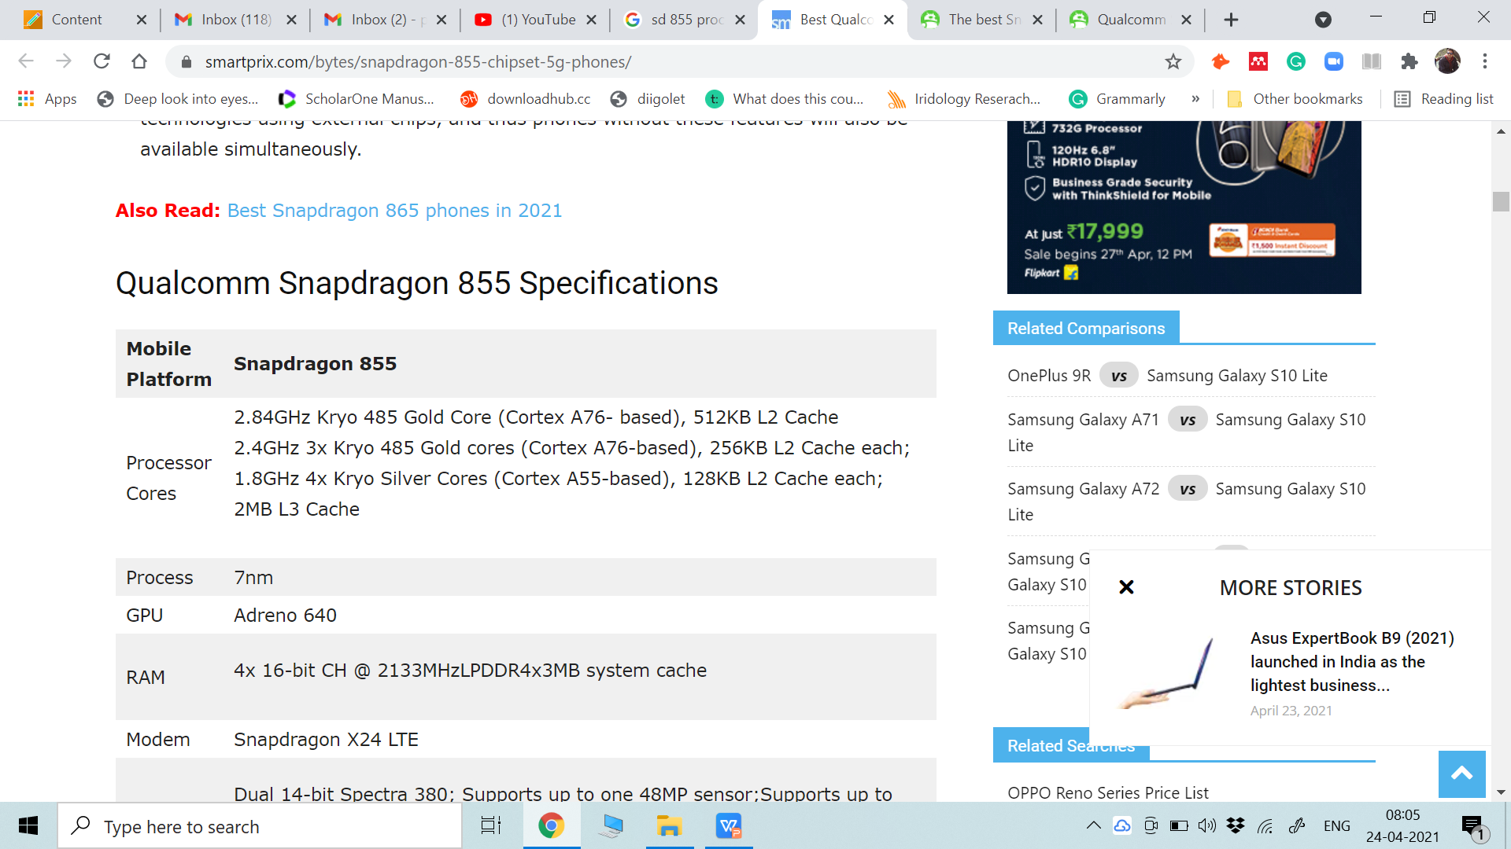
Qualcomm Snapdragon 855 Specifications
05/18/2021
ARM Architecture
<number>

Slide 103
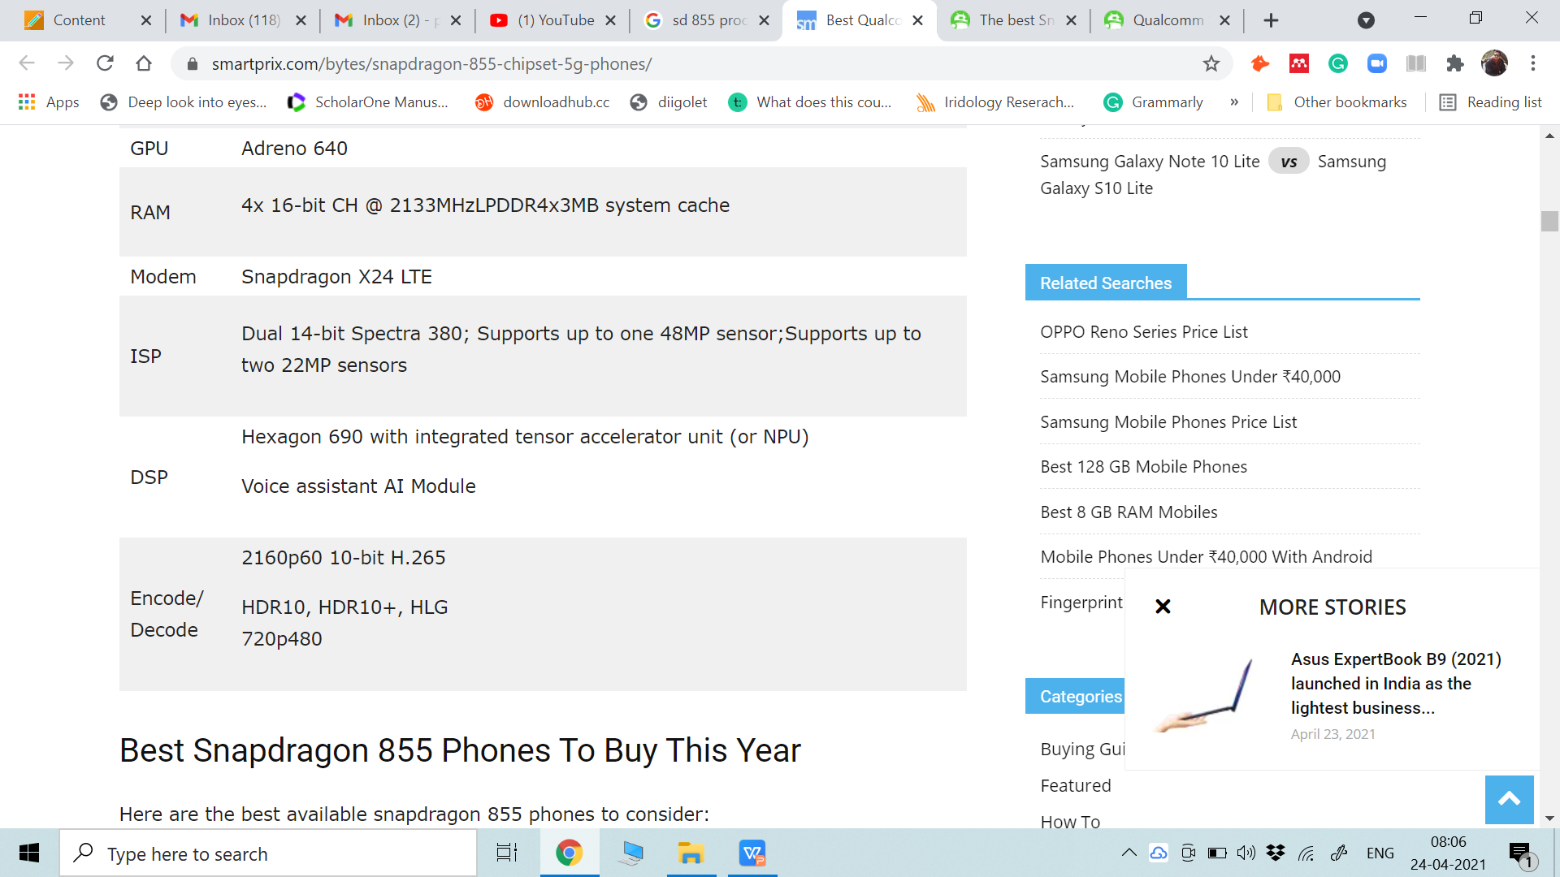
05/18/2021
ARM Architecture
<number>

